Slide 1
Data Scientist – Vidio Question 1
Created by Fuad Maulana

Slide 2
Video Category Analysis Based on Finished Video
In this analysis, i will look for user interest in the video category based on whether or not the video has been played.

Slide 3
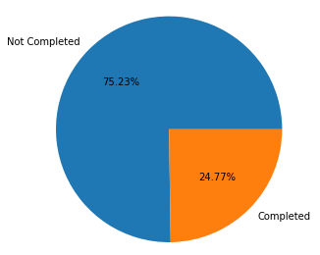
Percentage of Video Complete
There were 75.23% of the total videos that were watched but not finished, while the videos that were watched to completion were only 24.77% of the total. So it can be seen that many users watch the video but don’t finish it until the end of the video.

Slide 4
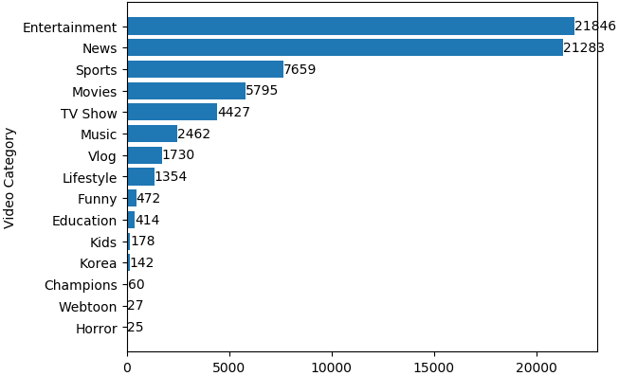
Number of Video Category
The entertainment and news categories have the largest number of videos, which is more than 21000 videos. While the webtoon and horror categories have the smallest number of videos, which less than 30 videos. So that it can be seen that users are more interested in watching videos in the entertainment and news categories. While the webtoon dan horror categories , users are less interested in watching the video

Slide 5
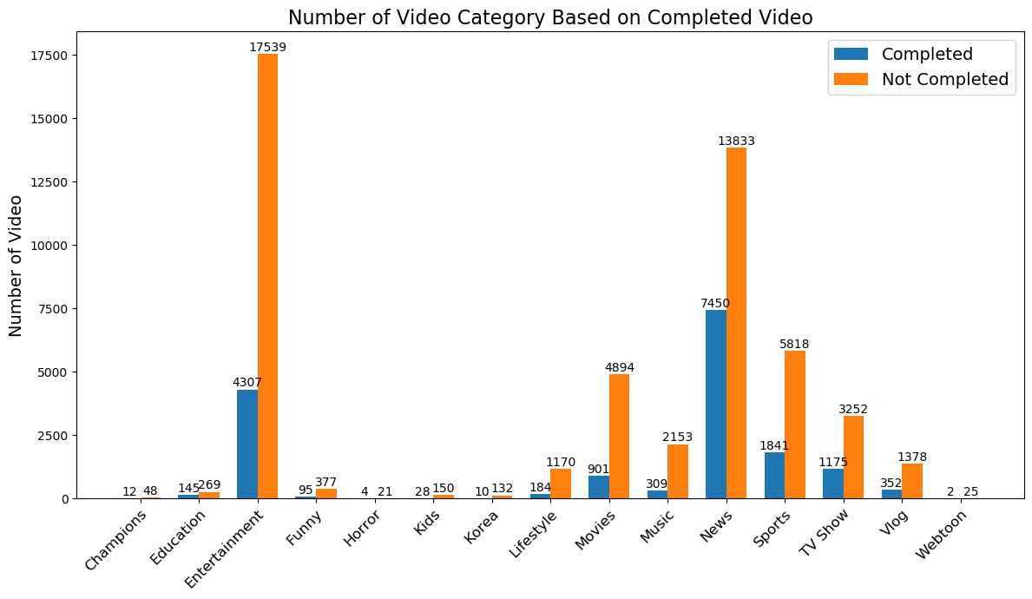
afadasd

Slide 6
Number of Video Category Based on Completed Video
For unfinished videos, the entertainment category had the largest number of videos with a total of 17539 videos. As for the videos that were completed, the news category had the largest number of videos with a total of 7450 videos.

Slide 7
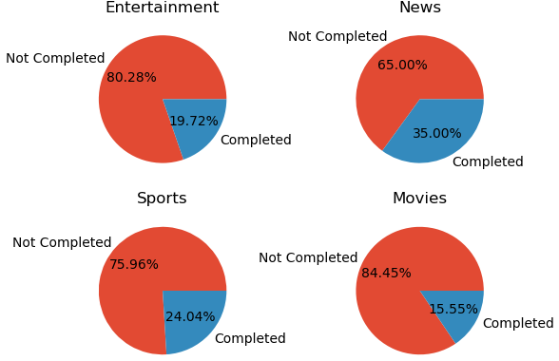
Percentage of Top 4 Video Category is Completed or Not
It is known that the entertainment and movies category has a percentage of more than 80% of unfinished videos. While the news category has a percentage of 35% of the completed videos. Customers have a high interest in these 4 categories. But many videos aren't watched till the end. This is possible due to several factors. one factor is the content of the video. The customers is curious about the video, but chooses not to watch the video until it's finished because the content of the video is not interesting. Of the 4 categories, the new category has the largest percentage of videos watched to completion by customers

